Slide 1





SPRING BOOT PROJECT
LECTURE - 2

Slide 2

Today’s Agenda
Exception Handling In Spring Boot
Spring Boot’s Default Handler
Using @ExceptionHandler
Using Global Exception Handler

Slide 3
Exception Handling In Spring Boot
Exception handling in Spring Boot helps to deal with errors and exceptions present in APIs, delivering a robust enterprise .
Here are some key approaches to exception handling in Spring Boot:
Let Spring Boot handle the exception
Using @ExceptionHandler annotation
Using @ControllerAdvice for global exception handling

Slide 4
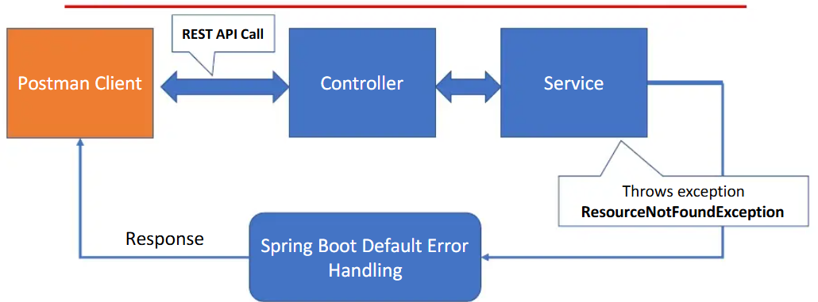
Spring Boot’s Default Exception Handling

Slide 5
Spring Boot’s Default Exception Handling
To understand what Spring Boot does by default when an exception occurs in an API , lets develop an Employee API.
It will allow the user to :
Add a new employee
Get details of an employee
Update an employee
Exception should be generated if:
While searching/updating the emp with given id is not found or
While adding a new emp , an emp with same name already exists( just for demonstration)

Slide 6
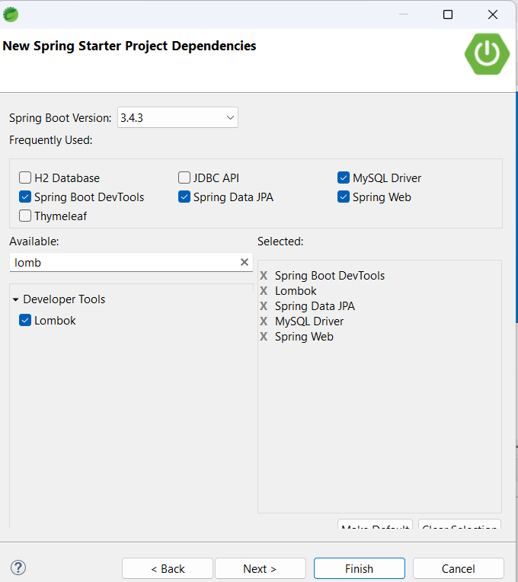
Step 2- Add Dependencies

Slide 7
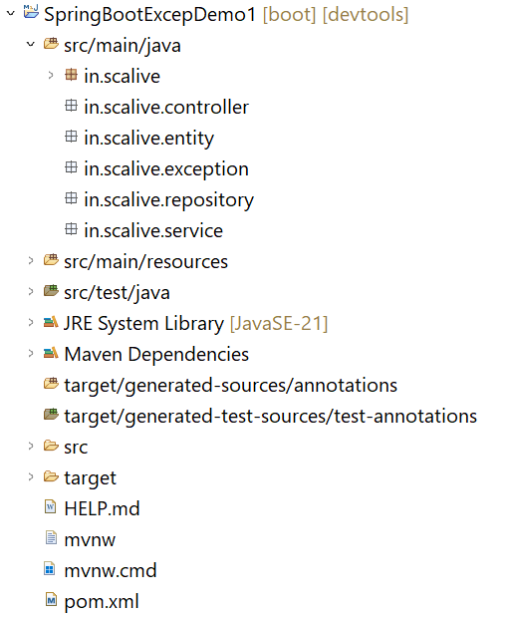
Step 3- Folder Structure

Slide 8
Step 4- Update The Properties File
spring.application.name=SpringBootExcepDemo1
spring.datasource.url=jdbc:mysql://localhost:3306/companydb
spring.datasource.username=root
spring.datasource.password=root123
spring.jpa.show-sql=true
spring.jpa.hibernate.ddl-auto=update
spring.jpa.database-platform=org.hibernate.dialect.MySQLDialect

Slide 9
Step 5- Design Emp Entity Class
package in.scalive.entity;
import jakarta.persistence.Entity;
import jakarta.persistence.GeneratedValue;
import jakarta.persistence.GenerationType;
import jakarta.persistence.Id;
import lombok.AllArgsConstructor;
import lombok.Data;
import lombok.NoArgsConstructor;
@Entity
@Data
@AllArgsConstructor
@NoArgsConstructor
public class Emp {
@Id
@GeneratedValue(strategy = GenerationType.IDENTITY)
private Integer empId;
private String ename;
private Double sal;
}

Slide 10
Step 6- Design EmpRepository Interface
package in.scalive.repository;
import java.util.Optional;
import org.springframework.data.jpa.repository.JpaRepository;
import org.springframework.stereotype.Repository;
import in.scalive.entity.Emp;
@Repository
public interface EmpRepository extends JpaRepository<Emp, Integer> {
public Optional<Emp> findByEname(String ename);
}

Slide 11
Step 7- Create EmpAlreadyExistsException
package in.scalive.exception;
public class EmpAlreadyExistsException extends RuntimeException {
public EmpAlreadyExistsException(String message) {
super(message);
}
}

Slide 12
Step 7- Create NoSuchEmpExistsException
package in.scalive.exception;
public class NoSuchEmpExistsException extends RuntimeException {
public NoSuchEmpExistsException(String message) {
super(message);
}
}

Slide 13
Step 8- Create EmpService Class
package in.scalive.service;
import org.springframework.beans.factory.annotation.Autowired;
import org.springframework.stereotype.Service;
import in.scalive.entity.Emp;
import in.scalive.exception.EmpAlreadyExistsException;
import in.scalive.exception.NoSuchEmpExistsException;
import in.scalive.repository.EmpRepository;
@Service
public class EmpService {
private EmpRepository repo;
@Autowired
public EmpService(EmpRepository repo) {
this.repo = repo;
}

Slide 14
Step 8- Create EmpService Class
public String addEmp(Emp empToAdd) {
Emp existingEmp=repo.findByEname(empToAdd.getEname()).orElse(null);
if(existingEmp!=null) {
throw new EmpAlreadyExistsException("Emp with name:"+empToAdd.getEname()+" already exists");
}
repo.save(empToAdd);
return "Emp saved successfully!";
}
public Emp getEmp(Integer empId) {
Emp e=repo.findById(empId).orElse(null);
if(e==null) {
throw new NoSuchEmpExistsException("Emp with id:"+empId+" does not exists");
}
return e;
}

Slide 15
Step 8- Create EmpService Class
public String updateEmp(Emp updatedEmp,Integer empId) {
Emp existingEmp=repo.findById(empId).orElse(null);
if(existingEmp==null) {
throw new NoSuchEmpExistsException("Emp with id:"+empId+" does not exists");
}
existingEmp.setEname(updatedEmp.getEname());
existingEmp.setSal(updatedEmp.getSal());
repo.save(existingEmp);
return "Emp updated successfully!";
}
}

Slide 16
Step 9- Create EmpController Class
package in.scalive.controller;
import org.springframework.web.bind.annotation.GetMapping;
import org.springframework.web.bind.annotation.PathVariable;
import org.springframework.web.bind.annotation.PostMapping;
import org.springframework.web.bind.annotation.PutMapping;
import org.springframework.web.bind.annotation.RequestBody;
import org.springframework.web.bind.annotation.RequestMapping;
import org.springframework.web.bind.annotation.RestController;
import in.scalive.entity.Emp;
import in.scalive.service.EmpService;
@RestController
@RequestMapping("/api/emp")
public class EmpController {
private EmpService serv;
public EmpController(EmpService serv) {
this.serv = serv;
}

Slide 17
Step 9- Create EmpController Class
@PostMapping("/add")
public String addEmp(@RequestBody Emp empToAdd) {
return serv.addEmp(empToAdd);
}
@GetMapping("/{empId}")
public Emp getEmp(@PathVariable("empId")Integer empId) {
return serv.getEmp(empId);
}
@PutMapping("/update/{empId}")
public String updateEmp(@RequestBody Emp updatedEmp,@PathVariable("empId")Integer empId) {
return serv.updateEmp(updatedEmp,empId); }
}

Slide 18
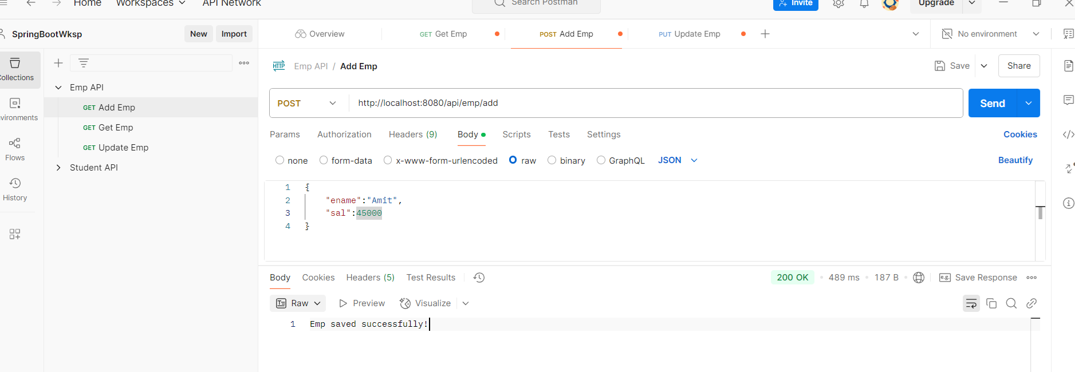
Step 10- Testing Using Postman
Adding A New Emp

Slide 19
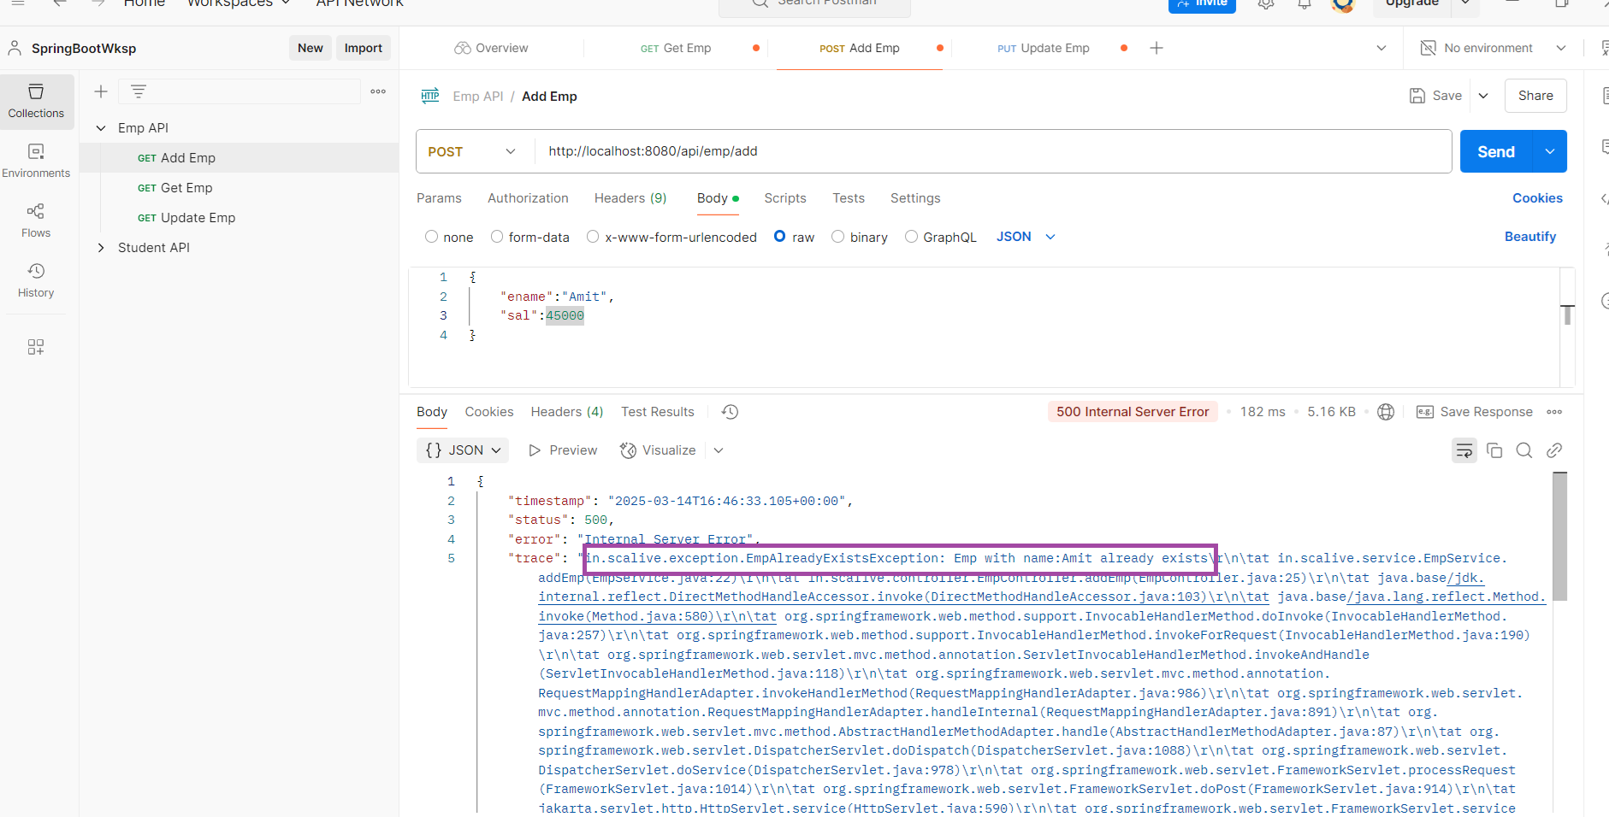
Step 10- Testing Using Postman
Adding Emp With Same Name

Slide 20
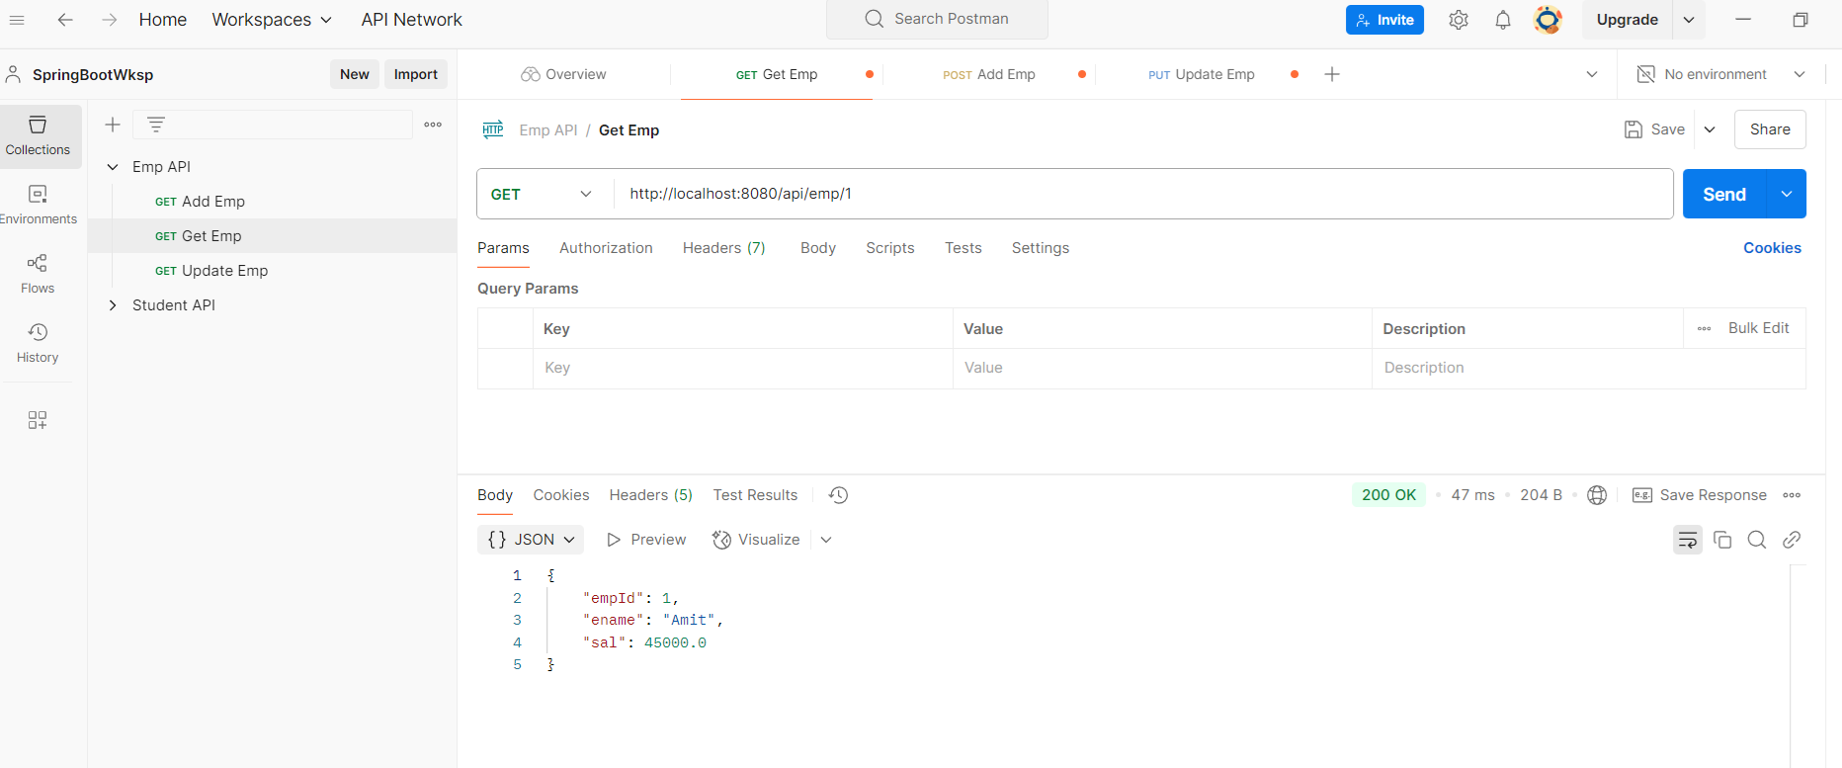
Step 10- Testing Using Postman
Get Emp Details

Slide 21
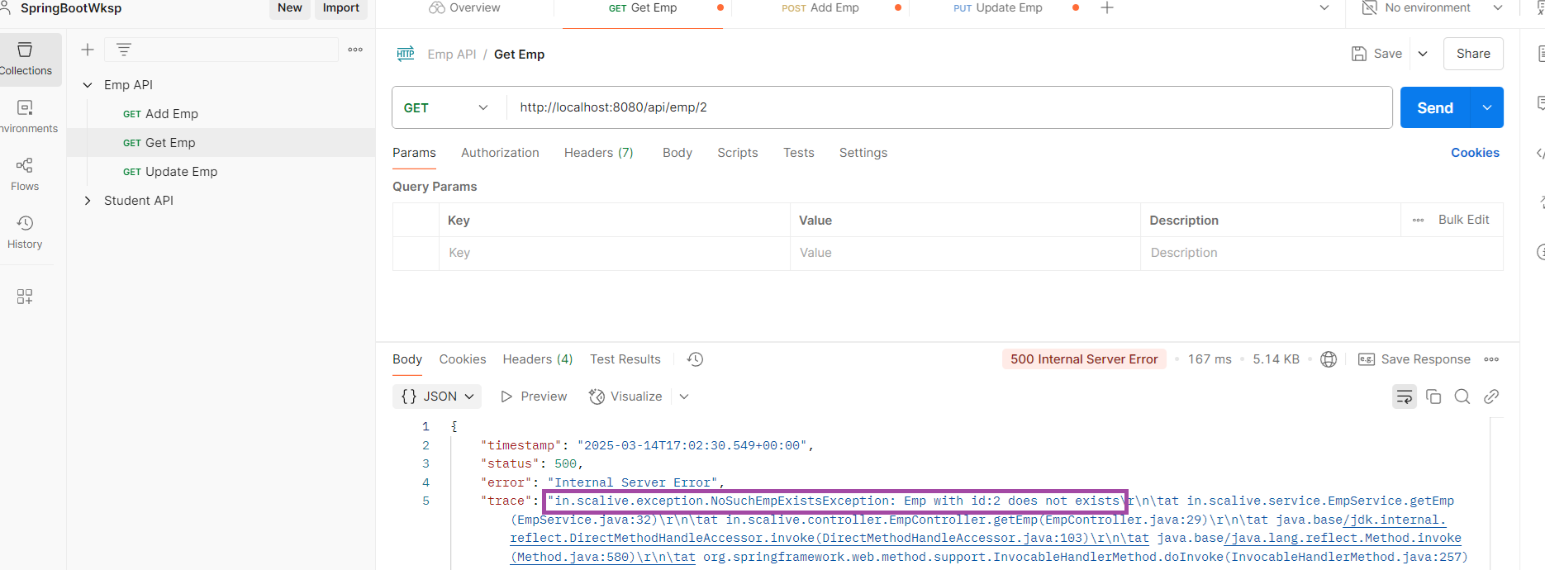
Step 10- Testing Using Postman
Get Non Existing Emp Details

Slide 22
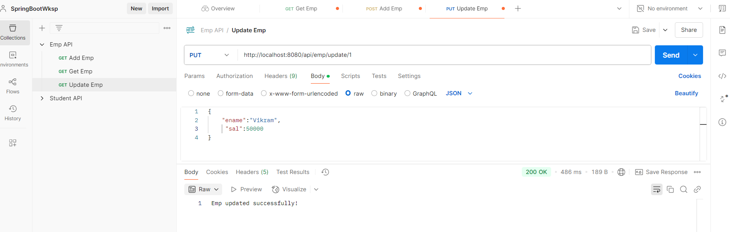
Step 10- Testing Using Postman
Update Emp Details

Slide 23
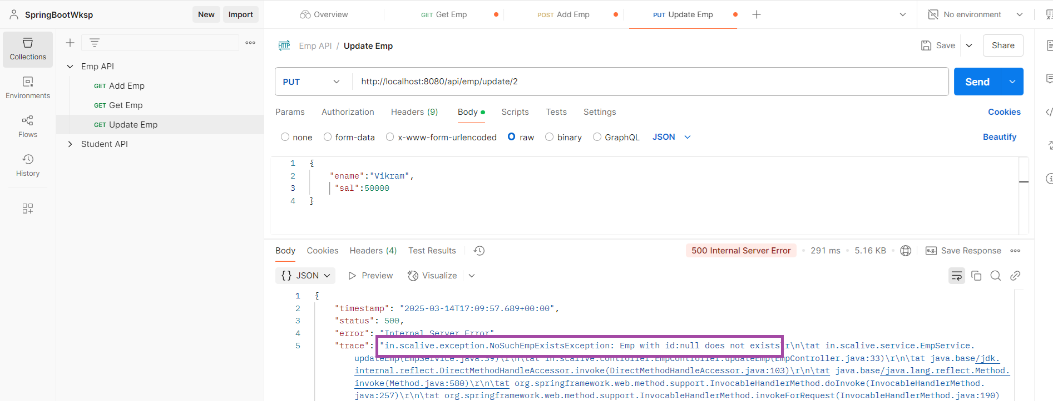
Step 10- Testing Using Postman
Update Non Existing Emp Details

Slide 24
Step 10- Testing Using Postman
Get Non Existing Emp Details

Slide 25
Spring Boot’s Default Exception Handling
We can observe that if an exception occurs then Spring Boot provides a detailed error response to the user.
This contains information such as timestamp, HTTP status code, error, message, and the path.
But this is not the recommended way of dealing with exceptions.

Slide 26
Problems With Default Exception Handling
Exposes Internal Details
Not User-Friendly
Inconsistent Response Format

Slide 27
Recommended Approach
Instead of relying on Spring Boot's default handler, we must use our own exception handling mechanism .
This can be done in 2 ways:
Using @ExceptionHandler
Using @ControllerAdvice

Slide 28
What Is @ExceptionHandler ?
It is an annotation in Spring Boot which can be used to handle exceptions in Handler methods.
Any method annotated with this is automatically recognized by Spring as an Exception Handler Method.
Syntax
@ExceptionHandler(value=<Name_Of_Exception.class>)
public <ret_type> <method_name>(<ExceptionClass> <ref>){
// body
}

Slide 29
What Is @ExceptionHandler ?
An Exception Handler method handles all exceptions and their subclasses passed in the argument.
It can also be configured to return a specific error response to the user.

Slide 30
Using @ExceptionHandler
Create a class called ErrorResponse with the data members representing the properties to be returned as exception result like statusCode and message.
Provide required constructors and setter and getters.
In the Controller class define a method with @ExceptionHandler annotation to handle the exception and return the ErrorResponse object.

Slide 31
The ErrorResponse Class
package in.scalive.exception;
import lombok.AllArgsConstructor;
import lombok.Data;
import lombok.NoArgsConstructor;
@Data
@AllArgsConstructor
@NoArgsConstructor
public class ErrorResponse {
private int statusCode;
private String messageString;
}

Slide 32
The Exception Handler Method In Controller
@ExceptionHandler(value = NoSuchEmpExistsException.class)
@ResponseStatus(HttpStatus.NOT_FOUND)
public ErrorResponse handleNoSuchEmpExistsException(NoSuchEmpExistsException ex) {
return new ErrorResponse(HttpStatus.NOT_FOUND.value(), ex.getMessage());
}
This status code will be returned to Postman/client to be shown as header. If not done the 200 will be returned

Slide 33
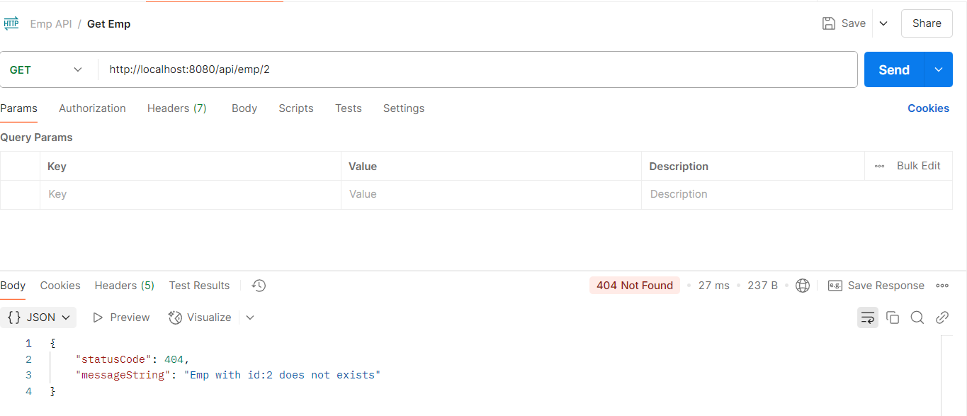
Testing Using Postman
Get Non Existing Emp Details

Slide 34
Using @ControllerAdvice
In the previous approach, there is a major drawback .
The drawback is that the @ExceptionHandler annotated method is only active for that particular Controller, not globally for the entire application.
For example if another Service class throws NoSuchEmpExistsException then the exception handler in our EmpController will not run.

Slide 35
Using @ControllerAdvice
However, if we want to handle the any exception thrown anywhere throughout the application, we can define a global exception handler class and annotate it with @ControllerAdvice .
This annotation helps to integrate multiple exception handlers into a single global unit.

Slide 36
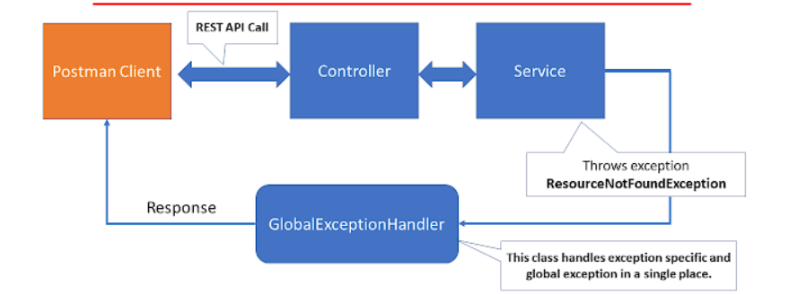
Using @ControllerAdvice

Slide 37
Using @ControllerAdvice
package in.scalive.exception;
import org.springframework.http.HttpStatus;
import org.springframework.web.bind.annotation.ControllerAdvice;
import org.springframework.web.bind.annotation.ExceptionHandler;
import org.springframework.web.bind.annotation.ResponseBody;
import org.springframework.web.bind.annotation.ResponseStatus;
@ControllerAdvice
public class GlobalExceptionHandler {
@ExceptionHandler(value = NoSuchEmpExistsException.class)
@ResponseStatus(HttpStatus.NOT_FOUND)
@ResponseBody
public ErrorResponse handleNoSuchEmpExistsException(NoSuchEmpExistsException ex) {
return new ErrorResponse(HttpStatus.NOT_FOUND.value(), ex.getMessage());
}
The @ResponseBody annotation ensures that the response returned by the exception handler is directly written as a JSON response instead of being interpreted as a view name.

Slide 38
Using @ControllerAdvice
@ExceptionHandler(value = EmpAlreadyExistsException.class)
@ResponseStatus(HttpStatus.CONFLICT)
@ResponseBody
public ErrorResponse handleEmpAlreadyExistsException(EmpAlreadyExistsException ex) {
return new ErrorResponse(HttpStatus.CONFLICT.value(), ex.getMessage());
}
}

Slide 39
Testing Using Postman
Get Non Existing Emp Details

Slide 40
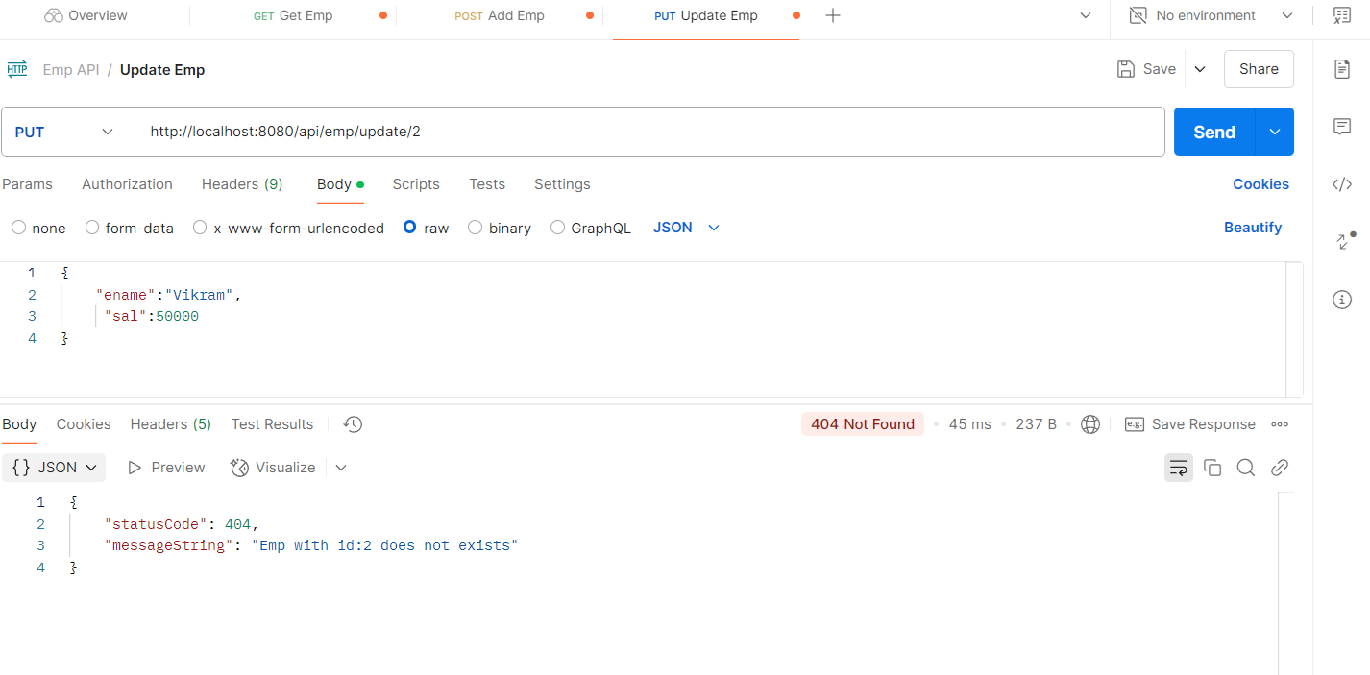
Testing Using Postman
Updating Non Existing Emp

Slide 41
Using ResponseEntity To Avoid @ResponseBody
As mentioned previously if we do not use @ResponseBody then Spring boot will assume that we are returning a view name rather than actual response.
And since we do not have any view created so code will throw a NoResourceFoundException.

Slide 42
Using ResponseEntity To Avoid @ResponseBody
To overcome this we can return a ResponseEntity object containing our ErrorResponse object.
Moreover when we do this we also do not require a separate @ResponseStatus as we can pass the status to ResponseEntity object itself.

Slide 43
Using ResponseEntity To Avoid @ResponseBody
package in.scalive.exception;
import org.springframework.http.HttpStatus;
import org.springframework.http.ResponseEntity;
import org.springframework.web.bind.annotation.ControllerAdvice;
import org.springframework.web.bind.annotation.ExceptionHandler;
@ControllerAdvice
public class GlobalExceptionHandler {
@ExceptionHandler(value = NoSuchEmpExistsException.class)
public ResponseEntity<ErrorResponse> handleNoSuchEmpExistsException(NoSuchEmpExistsException ex) {
ErrorResponse error=new ErrorResponse(HttpStatus.NOT_FOUND.value(), ex.getMessage());
return new ResponseEntity<>(error,HttpStatus.NOT_FOUND);
}
@ExceptionHandler(value = EmpAlreadyExistsException.class)
public ResponseEntity<ErrorResponse> handleEmpAlreadyExistsException(EmpAlreadyExistsException ex){
ErrorResponse error=new ErrorResponse(HttpStatus.CONFLICT.value(), ex.getMessage());
return new ResponseEntity<>(error,HttpStatus.NOT_FOUND);
}
}

Slide 44
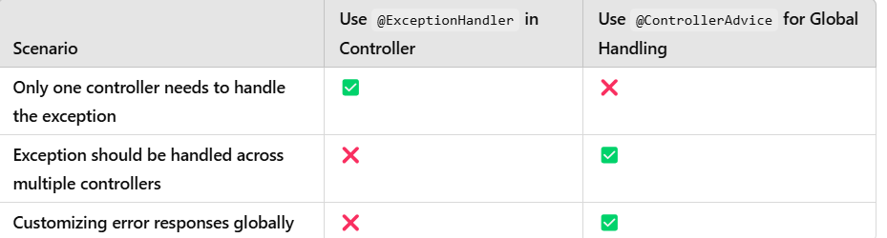
@ExceptionHandler V/s @ControllerAdvice

